Slide 1
Potential application of electro-hydrodynamic processing in paper and board- Use of cellulosic nanofibers for high performance papermaking products
COST Action FP1405 Active and intelligent fibre-based packaging – innovation and market introduction
Christian Kossel, Adriane Cherpinski and Jose M. Lagaron
christian.kossel@ptspaper.de

Slide 2
The Institutions
Home institution:
Papiertechnische Stiftung, Munich, Germany
Duration:
26- 09-16 -07-10-16
Hosting institution:
IATA-CSIC, Valencia, Spain
Notes:
high surface area per unit mass (1-100g/m²)

Slide 3
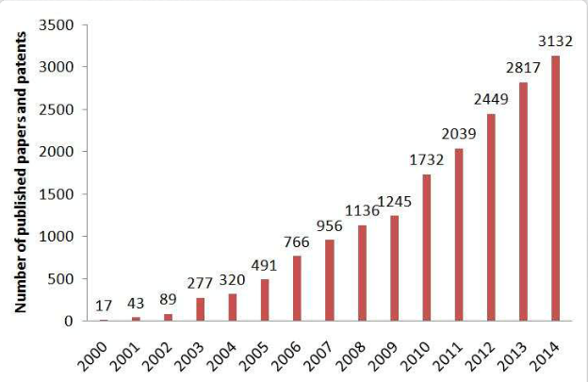
Introduction
Goal of the STSM:
Investigation of different materials and process conditions for producing cellulosic nanofibers by using electro-hydrodynamic processing
Advantages of electrospun fibers:
high surface area per unit mass
high aspect ratio (up to 1000)
high porosity (~90%)
lightweight, tuneable pore size
submicron to nanoscale diameter
high sensitivity to changes
in surrounding atmosphere
Haoyi Li et al. 2016
Notes:
high surface area per unit mass (1-100g/m²)

Slide 4
E - Spinning technique
Electrical potential (10– 50 kV) is applied
Pendant drop becomes highly electrified resulting in the deformation of liquid drops →Taylor cone
Voltage reaching a critical value: the electrostatic repulsion forces prevail over the solution surface tension →Jet ejection to collector
The jet becomes thinner in air due to fibre elongation and solvent evaporation.
d_{c}
Flowrate V̇
Voltage [V]
Electric field
E∞=V/d_{c}
Current [I]

Slide 5
Work plan
Two different types of PVOH were used
The concentration of PVOH was 12 wt/wt %, dissolved using a magnetic stirrer at 75°C for 24h.
The viscosity, surface tension and the conductivity were measured
Nanocrystals of cellulose (CNCs) were added in 1 wt/wt %
An additional PHB layer was coated on the top.
About 24 different samples were produced during the STSM

Slide 6
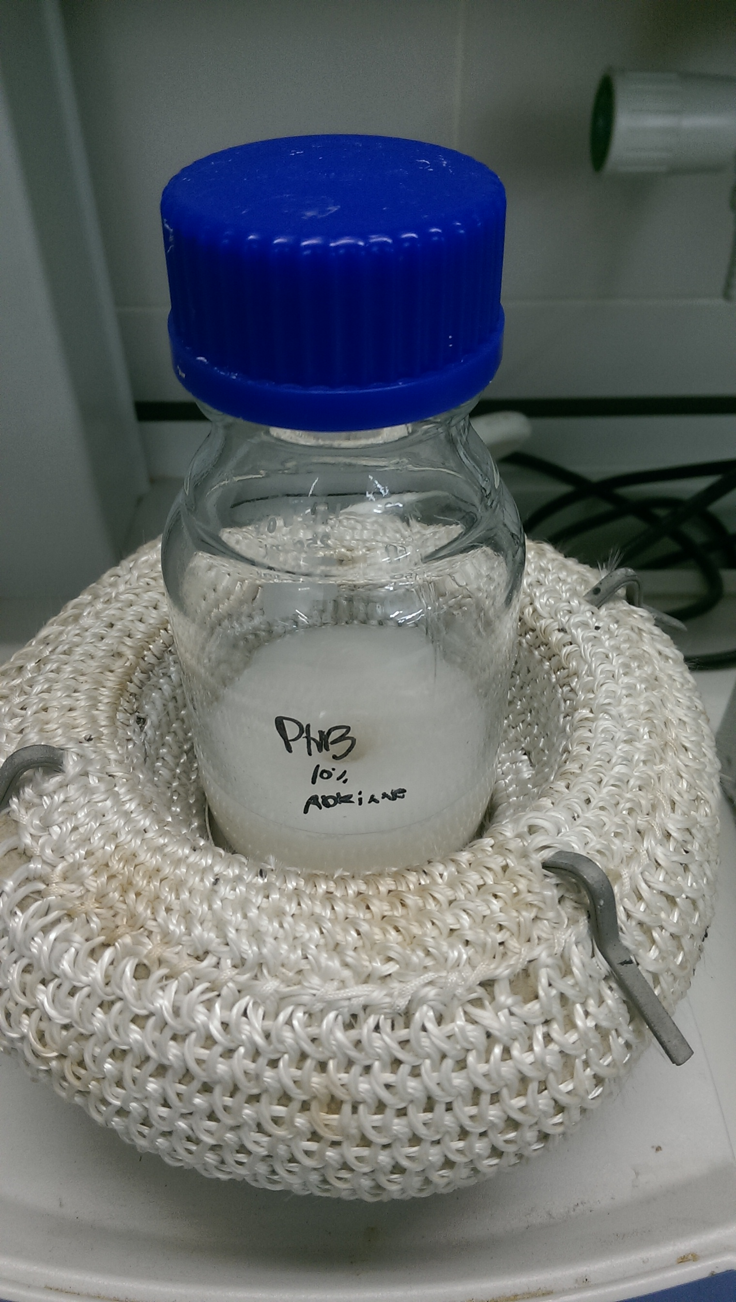
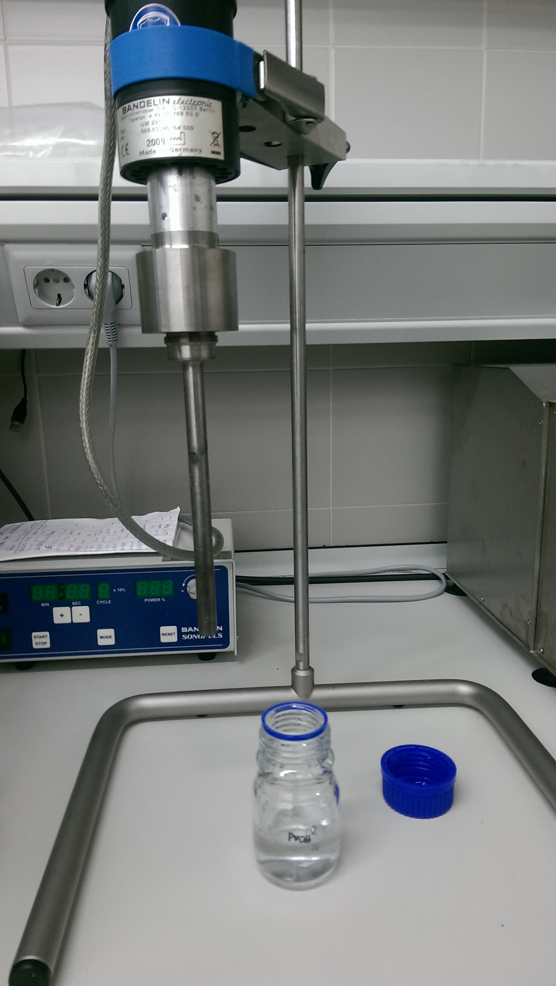
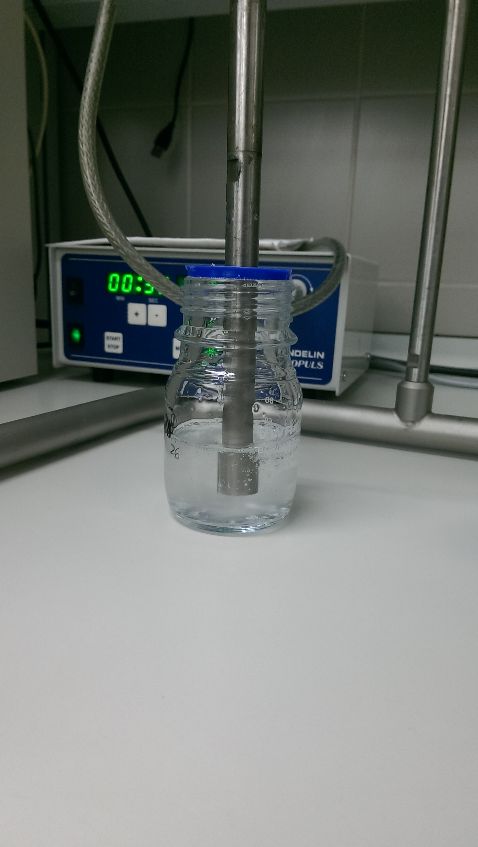
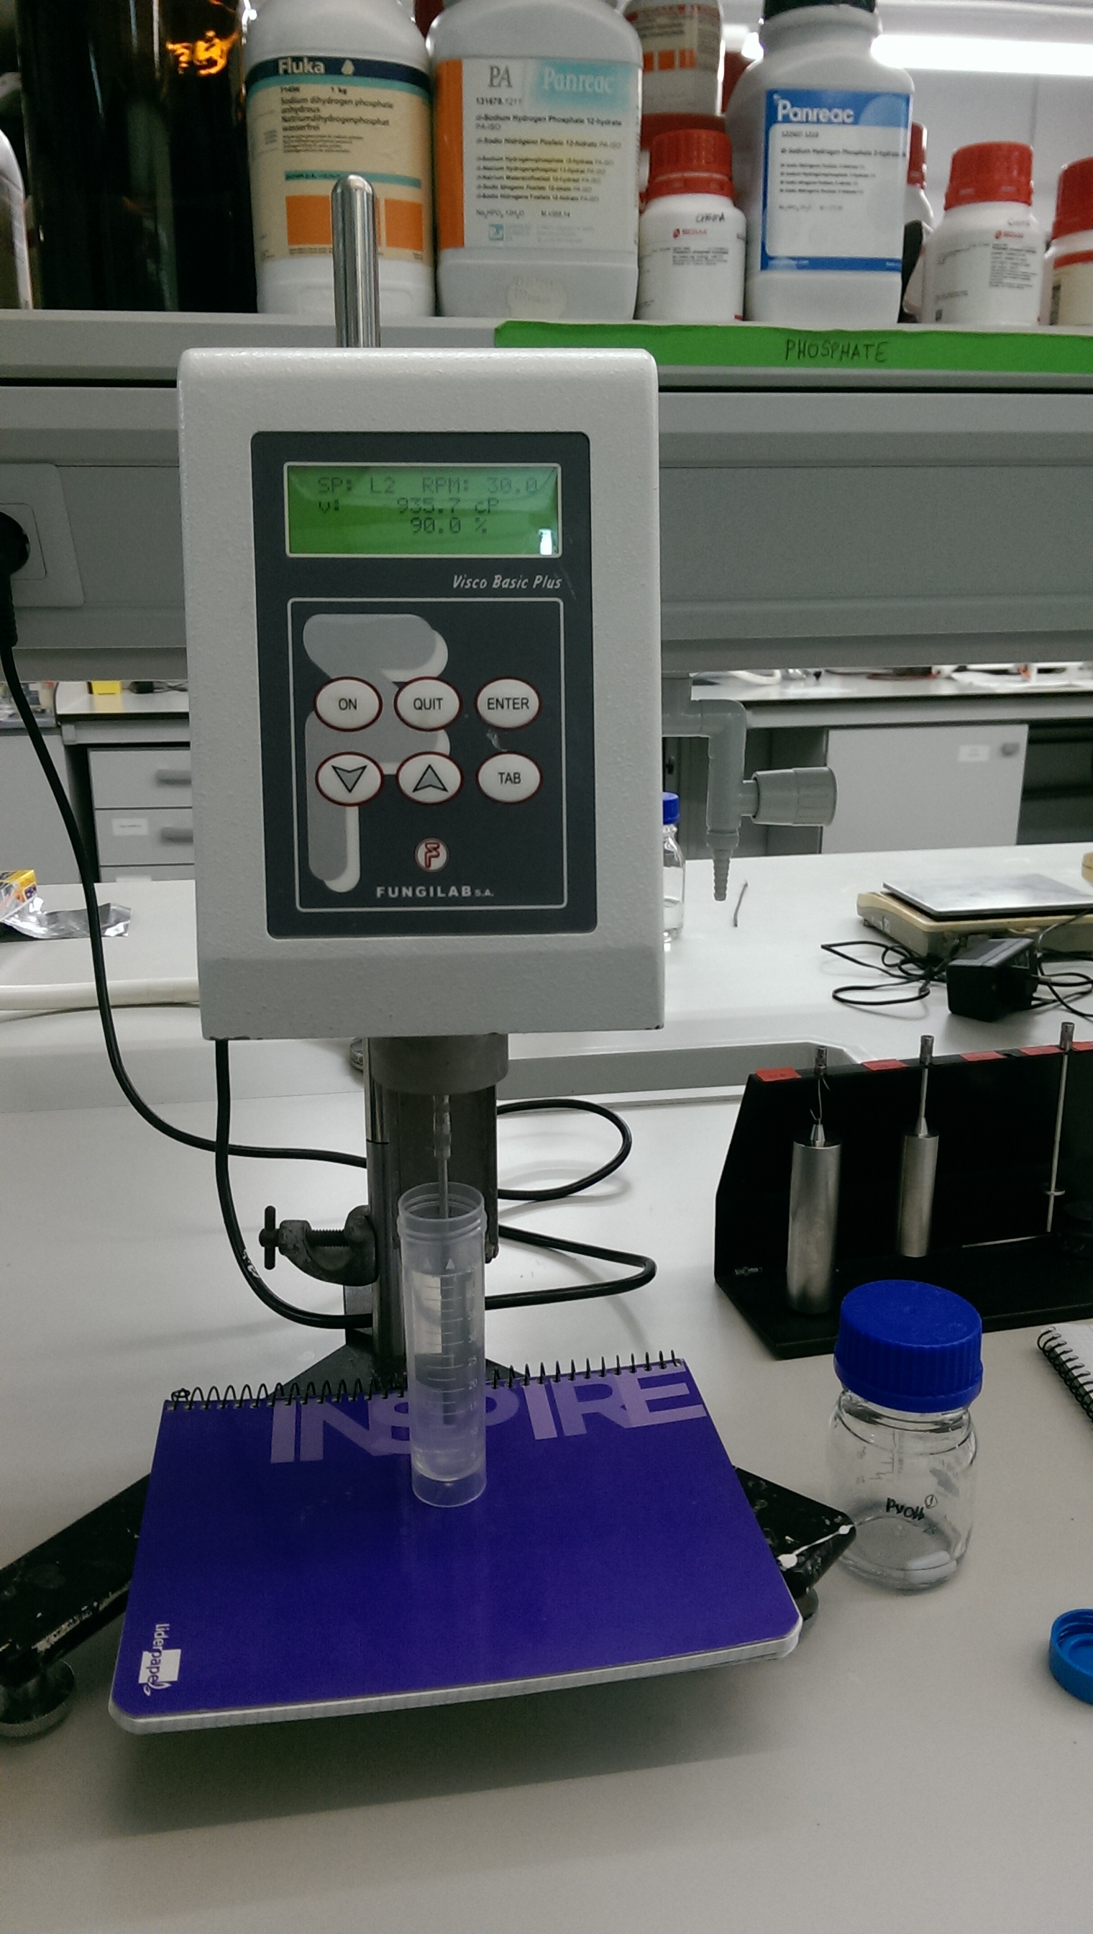
Impressions of the sample preparation

Slide 7
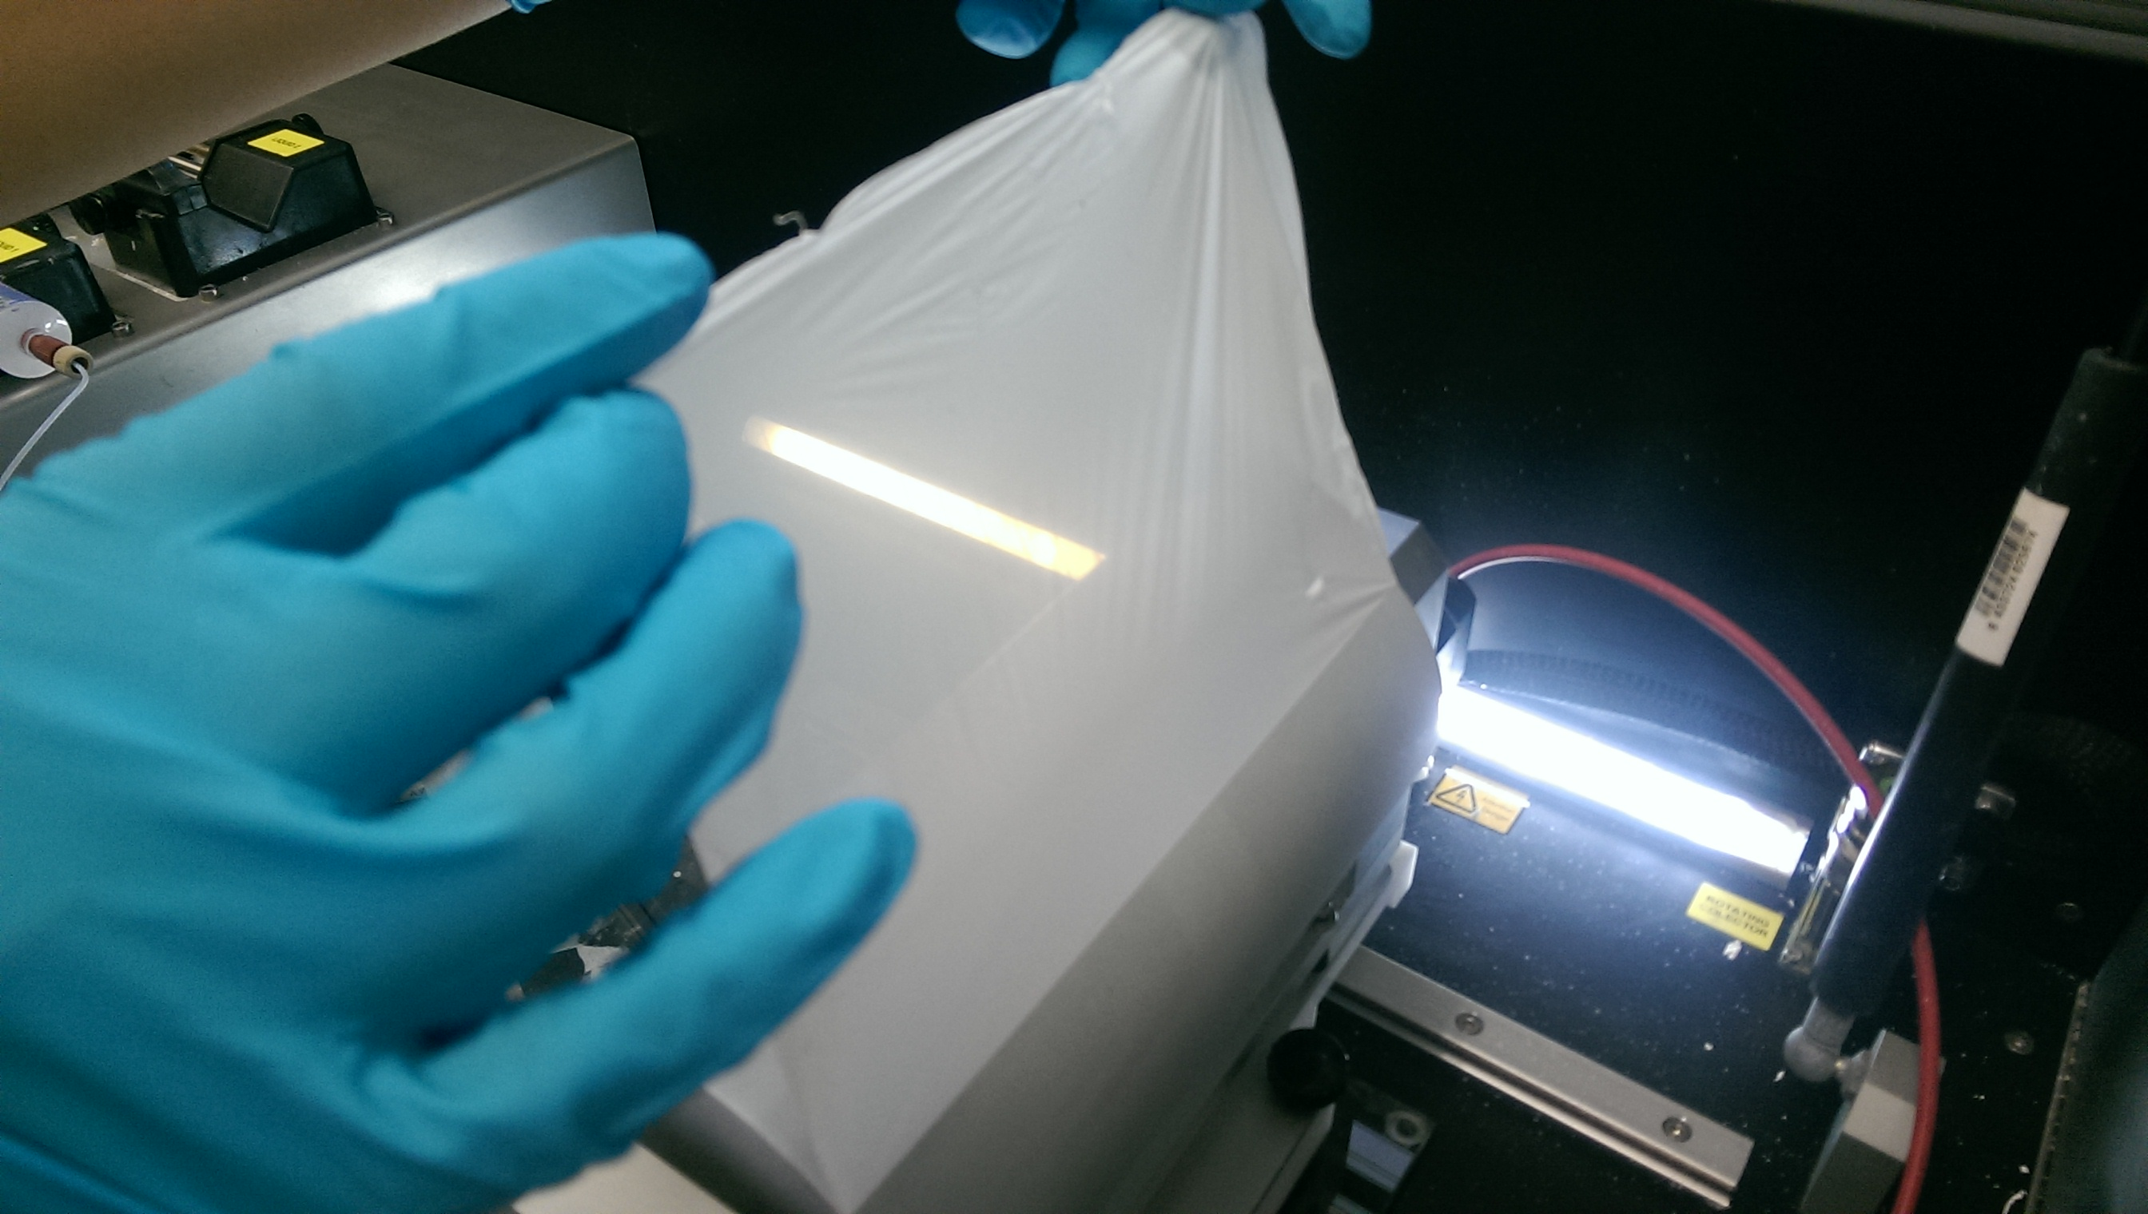
Adjustment of parameters I
The selected conditions generated a homogeneous electrospun PVOH film
Parameters LE-10 PVOH
$\dot{V}$ [ml/h]
d_{syringe} [mm]
V [kV]
rpm_{collector}
d_{c} [mm]
Results will be published in scientific papers (first quarter 2017) before being accessible to the public

Slide 8
Adjustment of parameters II
Post-processing of the electrospun films were carried out to improve fiber cohesion
Advantages:
Enhance adhesion
Improve membrane compactness (eliminate 'fluffiness' or stray fibers)
Improve mechanical and barrier properties
Results will be published in scientific papers (first quarter 2017) before being accessible to the public

Slide 9
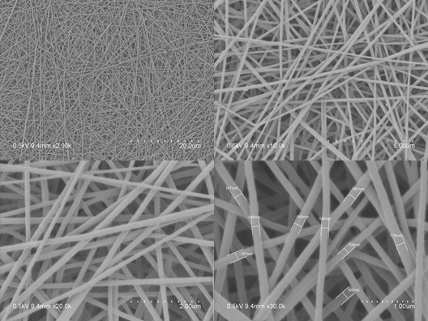
SEM analysis
SEM was used to analyse the structure and the morphology of the electrospun PVOH fibers
SEM images of PVOH 28 electrospun fibers with a magnification between 2k and 30k
The nanofiber diameter ranged between 145 -190 nm

Slide 10
PVOH - CNC solution on paper
After settings the parameters for PVOH solutions 1wt/wt% of CNC were added over uncoated paper
The paper itself had a grammage of 120g/m² and an A4 shape
Parameters LE-10 PVOH on paper
$\dot{V}$ [ml/h]
d_{syringe} [mm]
V [kV]
rpm_{collector}
d_{c} [mm]
t_{Spinning} [h]
Results will be published in scientific papers (first quarter 2017) before being accessible to the public

Slide 11
PVOH - CNC - PHB on paper
A PHB coating was added as an additional hydrophobic layer on a PVOH+CNC precoated paper
Parameters LE-10 PHB on paper
$\dot{V}$ [ml/h]
d_{syringe} [mm]
V [kV]
rpm_{collector}
d_{c} [mm]
t_{Spinning} [h]
Results will be published in scientific papers (first quarter 2017) before being accessible to the public

Slide 12
Characterization at PTS
Grease resistance → KIT- Test according to TAPPI T559
Water absorptiveness according to Cobb-Test (ISO 535)
Surface tension / polarity of surfaces and contact angle according to PTS-PP:103/85
Foldability and scoring characteristics according to DIN 55 437-2
Roughness/permeability meter according to Bendtsen (ISO 8791-2 )
Results will be published in scientific papers (first quarter 2017) before being accessible to the public

Slide 13
On-Going Work at CSIC
Method |  | E-Spin coated | outcome
SEM | fiber diameter and morphology | in progress
TEM | fiber diameter and morphology | in progress
DSC | thermal properties (crystallization) | in progress
WVTR | barrier properties | in progress
OTR | barrier properties | in progress
Aroma barrier (Limonene) | barrier properties | in progress
Results will be published in scientific papers (first quarter 2017) before being accessible to the public

Slide 14
Conclusions and further work
To achieve good results the machine parameters (V̇, V, rpm, tip-to collector-distance, t_{spinning}) as well as the material parameters (viscosity, concentration, MW, surface tension and conductivity) had to be optimized
The results suggest that the use of nanocellulose as a filler in combination with PVOH shows great potential to produce fully biobased paper with potentially enhanced properties
During my STSM at the IATA-CSIC institute in Valencia, I had the possibility to work in a very positive and productive atmosphere.
Both institutes, IATA-CSIC and PTS, will continue to collaborate on the topic due the synergies generated. Therefore a long-term collaboration is intended.

Slide 15
Thank you FOR YOUR ATTENTION
Christian Kossel
Tel +49 89 / 12146-597
christian.kossel@ptspaper.de
End of presentation

